Slide 1
Data Structure and Algorithms
Sorting

Slide 2
Review: Asymptotic Notation
Upper Bound Notation:
  f(n) = O(g(n)) if there exist positive constants c and n₀ such that f(n) ≤ c ⋅ g(n) for all n ≥ n₀
  Formally, O(g(n)) = { f(n): ∃ positive constants c and n₀ such that f(n) ≤ c ⋅ g(n) ∀ n ≥ n₀

Slide 3
Review: Asymptotic Notation
Asymptotic lower bound:
  f(n) is Ω(g(n)) if ∃ positive constants c and n₀ such that 0 ≤ c⋅g(n) ≤ f(n) ∀ n ≥ n₀
Asymptotic tight bound:
  f(n) is Θ(g(n)) if ∃ positive constants c₁, c₂, and n₀ such that c₁ g(n) ≤ f(n) ≤ c₂ g(n) ∀ n ≥ n₀
  f(n) = Θ(g(n)) if and only if
  f(n) = O(g(n)) AND f(n) = Ω(g(n))

Slide 4
Other Asymptotic Notations
A function f(n) is o(g(n)) if ∃ positive constants c and n₀ such that
f(n) < c g(n) ∀ n ≥ n₀
A function f(n) is ω(g(n)) if ∃ positive constants c and n₀ such that
c g(n) < f(n) ∀ n ≥ n₀
Intuitively,
  o() is like <
  O() is like ≤
  ω() is like >
  Ω() is like ≥
  Θ() is like =

Slide 5
Sorting
Sorting is a process in which records are arranged in ascending or descending order
1 2 3 4 5 6
77
42
35
12
101
5
1 2 3 4 5 6
5
12
35
42
77
101

Slide 6
Several sorting algorithms
Selection sort
Insertion sort
Bubble sort
Merge sort
Quick sort
… …

Slide 7
Mergesort

Slide 8
Divide and Conquer
Divide and Conquer cuts the problem in half each time, but uses the result of both halves:
  cut the problem in half until the problem is trivial
  solve for both halves
  combine the solutions

Slide 9
Mergesort
A divide-and-conquer algorithm:
Divide the unsorted array into 2 halves until the sub-arrays only contain one element
Merge the sub-problem solutions together:
  Compare the sub-array’s first elements
  Remove the smallest element and put it into the result array
  Continue the process until all elements have been put into the result array
37
23
6
89
15
12
2
19

Slide 10
98
23
45
14
6
67
33
42

Slide 11
98
23
45
14
6
67
33
42
98
23
45
14
6
67
33
42

Slide 12
98
23
45
14
6
67
33
42
98
23
45
14
6
67
33
42
98
23
45
14

Slide 13
98
23
45
14
6
67
33
42
98
23
45
14
6
67
33
42
98
23
45
14
98
23

Slide 14
98
23
45
14
6
67
33
42
98
23
45
14
6
67
33
42
98
23
45
14
98
23
Merge

Slide 15
98
23
45
14
6
67
33
42
98
23
45
14
6
67
33
42
98
23
45
14
98
23
23
Merge

Slide 16
98
23
45
14
6
67
33
42
98
23
45
14
6
67
33
42
98
23
45
14
98
23
23
98
Merge

Slide 17
98
23
45
14
6
67
33
42
98
23
45
14
6
67
33
42
98
23
45
14
98
23
45
14
23
98

Slide 18
98
23
45
14
6
67
33
42
98
23
45
14
6
67
33
42
98
23
45
14
98
23
45
14
23
98
Merge

Slide 19
98
23
45
14
6
67
33
42
98
23
45
14
6
67
33
42
98
23
45
14
98
23
45
14
23
98
14
Merge

Slide 20
98
23
45
14
6
67
33
42
98
23
45
14
6
67
33
42
98
23
45
14
98
23
45
14
23
98
14
45
Merge

Slide 21
98
23
45
14
6
67
33
42
98
23
45
14
6
67
33
42
98
23
45
14
98
23
45
14
23
98
14
45
Merge

Slide 22
98
23
45
14
6
67
33
42
98
23
45
14
6
67
33
42
98
23
45
14
98
23
45
14
23
98
14
45
14
Merge

Slide 23
98
23
45
14
6
67
33
42
98
23
45
14
6
67
33
42
98
23
45
14
98
23
45
14
23
98
14
45
14
23
Merge

Slide 24
98
23
45
14
6
67
33
42
98
23
45
14
6
67
33
42
98
23
45
14
98
23
45
14
23
98
14
45
14
23
45
Merge

Slide 25
98
23
45
14
6
67
33
42
98
23
45
14
6
67
33
42
98
23
45
14
98
23
45
14
23
98
14
45
14
23
45
98
Merge

Slide 26
98
23
45
14
6
67
33
42
98
23
45
14
6
67
33
42
98
23
45
14
6
67
33
42
98
23
45
14
23
98
14
45
14
23
45
98

Slide 27
98
23
45
14
6
67
33
42
98
23
45
14
6
67
33
42
98
23
45
14
6
67
33
42
98
23
45
14
6
67
23
98
14
45
14
23
45
98

Slide 28
98
23
45
14
6
67
33
42
98
23
45
14
6
67
33
42
98
23
45
14
6
67
33
42
98
23
45
14
6
67
23
98
14
45
14
23
45
98
Merge

Slide 29
98
23
45
14
6
67
33
42
98
23
45
14
6
67
33
42
98
23
45
14
6
67
33
42
98
23
45
14
6
67
23
98
14
45
6
14
23
45
98
Merge

Slide 30
98
23
45
14
6
67
33
42
98
23
45
14
6
67
33
42
98
23
45
14
6
67
33
42
98
23
45
14
6
67
23
98
14
45
6
67
14
23
45
98
Merge

Slide 31
98
23
45
14
6
67
33
42
98
23
45
14
6
67
33
42
98
23
45
14
6
67
33
42
98
23
45
14
6
67
33
42
23
98
14
45
6
67
14
23
45
98

Slide 32
98
23
45
14
6
67
33
42
98
23
45
14
6
67
33
42
98
23
45
14
6
67
33
42
98
23
45
14
6
67
33
42
23
98
14
45
6
67
14
23
45
98
Merge

Slide 33
98
23
45
14
6
67
33
42
98
23
45
14
6
67
33
42
98
23
45
14
6
67
33
42
98
23
45
14
6
67
33
42
23
98
14
45
6
67
33
14
23
45
98
Merge

Slide 34
98
23
45
14
6
67
33
42
98
23
45
14
6
67
33
42
98
23
45
14
6
67
33
42
98
23
45
14
6
67
33
42
23
98
14
45
6
67
33
42
14
23
45
98
Merge

Slide 35
98
23
45
14
6
67
33
42
98
23
45
14
6
67
33
42
98
23
45
14
6
67
33
42
98
23
45
14
6
67
33
42
23
98
14
45
6
67
33
42
14
23
45
98
Merge

Slide 36
98
23
45
14
6
67
33
42
98
23
45
14
6
67
33
42
98
23
45
14
6
67
33
42
98
23
45
14
6
67
33
42
23
98
14
45
6
67
33
42
14
23
45
98
6
Merge

Slide 37
98
23
45
14
6
67
33
42
98
23
45
14
6
67
33
42
98
23
45
14
6
67
33
42
98
23
45
14
6
67
33
42
23
98
14
45
6
67
33
42
14
23
45
98
6
33
Merge

Slide 38
98
23
45
14
6
67
33
42
98
23
45
14
6
67
33
42
98
23
45
14
6
67
33
42
98
23
45
14
6
67
33
42
23
98
14
45
6
67
33
42
14
23
45
98
6
33
42
Merge

Slide 39
98
23
45
14
6
67
33
42
98
23
45
14
6
67
33
42
98
23
45
14
6
67
33
42
98
23
45
14
6
67
33
42
23
98
14
45
6
67
33
42
14
23
45
98
6
33
42
67
Merge

Slide 40
98
23
45
14
6
67
33
42
98
23
45
14
6
67
33
42
98
23
45
14
6
67
33
42
98
23
45
14
6
67
33
42
23
98
14
45
6
67
33
42
14
23
45
98
6
33
42
67
Merge

Slide 41
98
23
45
14
6
67
33
42
98
23
45
14
6
67
33
42
98
23
45
14
6
67
33
42
98
23
45
14
6
67
33
42
23
98
14
45
6
67
33
42
14
23
45
98
6
33
42
67
6
Merge

Slide 42
98
23
45
14
6
67
33
42
98
23
45
14
6
67
33
42
98
23
45
14
6
67
33
42
98
23
45
14
6
67
33
42
23
98
14
45
6
67
33
42
14
23
45
98
6
33
42
67
6
14
Merge

Slide 43
98
23
45
14
6
67
33
42
98
23
45
14
6
67
33
42
98
23
45
14
6
67
33
42
98
23
45
14
6
67
33
42
23
98
14
45
6
67
33
42
14
23
45
98
6
33
42
67
6
14
23
Merge

Slide 44
98
23
45
14
6
67
33
42
98
23
45
14
6
67
33
42
98
23
45
14
6
67
33
42
98
23
45
14
6
67
33
42
23
98
14
45
6
67
33
42
14
23
45
98
6
33
42
67
6
14
23
33
Merge

Slide 45
98
23
45
14
6
67
33
42
98
23
45
14
6
67
33
42
98
23
45
14
6
67
33
42
98
23
45
14
6
67
33
42
23
98
14
45
6
67
33
42
14
23
45
98
6
33
42
67
6
14
23
33
42
Merge

Slide 46
98
23
45
14
6
67
33
42
98
23
45
14
6
67
33
42
98
23
45
14
6
67
33
42
98
23
45
14
6
67
33
42
23
98
14
45
6
67
33
42
14
23
45
98
6
33
42
67
6
14
23
33
42
45
Merge

Slide 47
98
23
45
14
6
67
33
42
98
23
45
14
6
67
33
42
98
23
45
14
6
67
33
42
98
23
45
14
6
67
33
42
23
98
14
45
6
67
33
42
14
23
45
98
6
33
42
67
6
14
23
33
42
45
67
Merge

Slide 48
98
23
45
14
6
67
33
42
98
23
45
14
6
67
33
42
98
23
45
14
6
67
33
42
98
23
45
14
6
67
33
42
23
98
14
45
6
67
33
42
14
23
45
98
6
33
42
67
6
14
23
33
42
45
67
98
Merge

Slide 49
98
23
45
14
6
67
33
42
98
23
45
14
6
67
33
42
98
23
45
14
6
67
33
42
98
23
45
14
6
67
33
42
23
98
14
45
6
67
33
42
14
23
45
98
6
33
42
67
6
14
23
33
42
45
67
98

Slide 50
98
23
45
14
6
67
33
42
6
14
23
33
42
45
67
98

Slide 51
Algorithm
Mergesort(Passed an array)
if array size > 1
Divide array in half
Call Mergesort on first half.
Call Mergesort on second half.
Merge two halves.
Merge(Passed two arrays)
Compare leading element in each array
Select lower and place in new array.
(If one input array is empty then place
remainder of other array in output array)

Slide 52
Merge Sort
We don’t really pass in two arrays!
We pass in one array with indicator variables which tell us where one set of data starts and finishes and where the other set of data starts and finishes.
s1
f1
s2
f2

Slide 53
Merge Sort
MergeSort(A, left, right) {
if (left < right) {
mid = floor((left + right) / 2);
MergeSort(A, left, mid);
MergeSort(A, mid+1, right);
Merge(A, left, mid, right);
}
}
// Merge() takes two sorted subarrays of A and
// merges them into a single sorted subarray of A
// (how long should this take?)

Slide 54
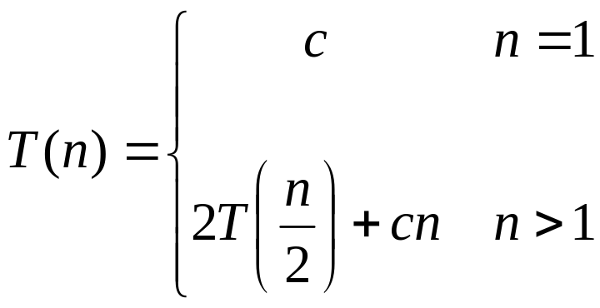
Recurrences
The expression:
is a recurrence.
  Recurrence: an equation that describes a function in terms of its value on smaller functions

Slide 55

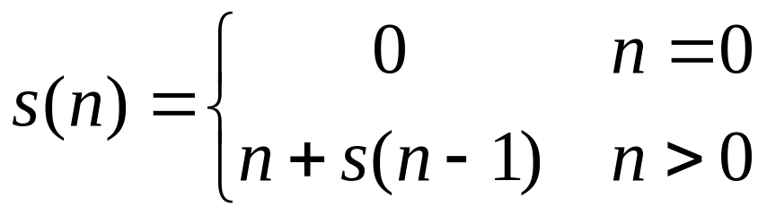

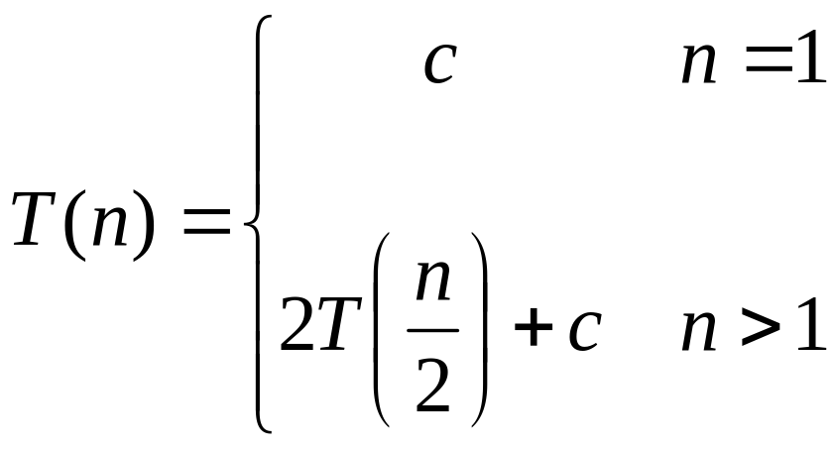
Recurrence Examples

Slide 56
Solving Recurrences
Substitution method
Iteration method
Master method

Slide 57
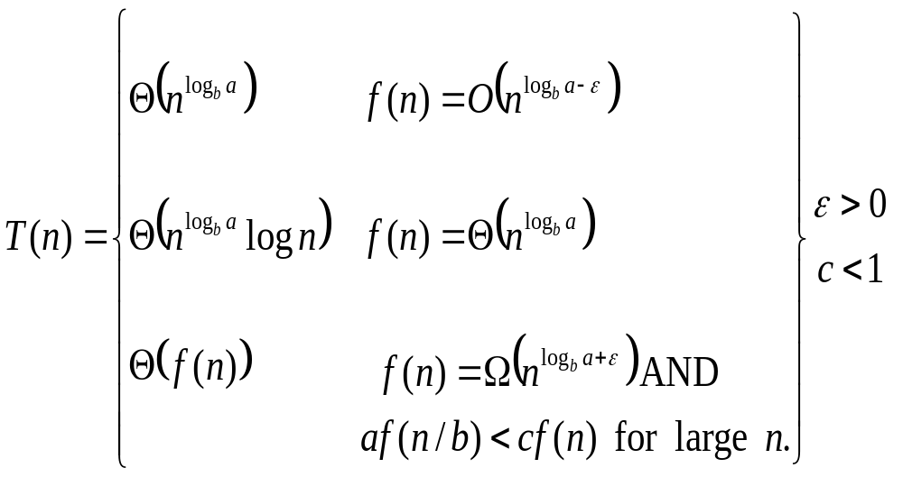
The Master Theorem
if T(n) = aT(n/b) + f(n) then

Slide 58
The Master Theorem
if T(n) = aT(n/b) + f(n) then
Eg: T(n) = 8T(n/2) + 10n² =Θ(n³), log_{b}ª = log₂⁸ = 3
Eg: T(n) = 2T(n/2) + 10n =Θ(nlogn), log_{b}ª = log₂² = 1
Eg: T(n) = 2T(n/2) + n² =Θ(n²), log_{b}ª = log₂² = 1

Slide 59
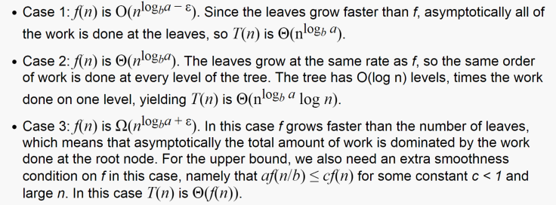
Why?
https://www.cs.cornell.edu/courses/cs3110/2012sp/lectures/lec20-master/lec20.html

Slide 60
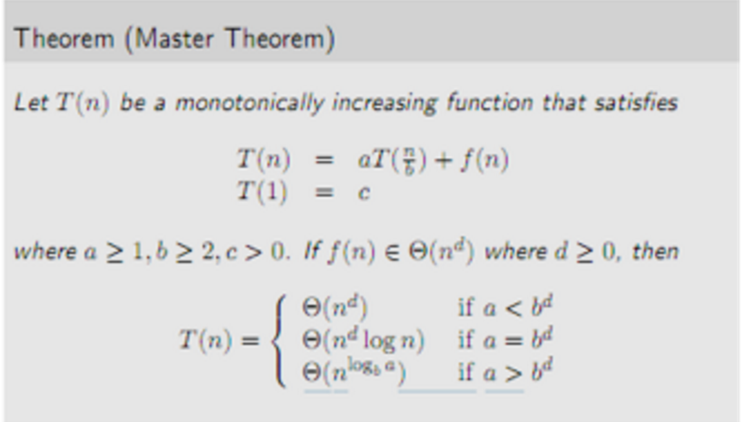

Another way to see this
https://devsathish.wordpress.com/2012/01/19/master-theorem-with-examples/

Slide 61
Using The Master Method
T(n) = 9T(n/3) + n
  a=9, b=3, f(n) = n
  n^{logb a} = n^{log3 9} = Θ(n²)
  Since f(n) = O(n^{log3 9 - ε}), where ε=1, case 1 applies:
  Thus the solution is T(n) = Θ(n²)

Slide 62
Complexity of Mergesort
This one is O(n log n)

Slide 63
References
http://www.cs.virginia.edu/~luebke/cs332/

